Slide 1
Deployment using Bamboo

Slide 2
Bamboo – Build
Team Foundation Server
Packaged File 1
BuildConfig File
<TFD Path>
<Branch>
<etc..)
Bamboo Jobs
Bamboo Jobs
Packaged File 2
Bamboo Jobs
Source Code Task
Packaged File 3
Build Task
Solution File
Notes:
Slide not required to be covered during the presentation, but could be left to give a context for offline readers

Slide 3
Bamboo – Deploy
Deployment Projects
Deploy Config File
<Package >
<Deployment type>
<Any other…>
Deployment Projects-1
Deploy-Dev
Deployment in Dev
Task “Dev”
Deploy-Test
Deployment in Test
Task “Test”
Package File
Deploy-Pre Prod
Deployment in Pre-Prod
Environment type ???
Task “Pre=Prod”
Notes:
Slide not required to be covered during the presentation, but could be left to give a context for offline readers

Slide 4
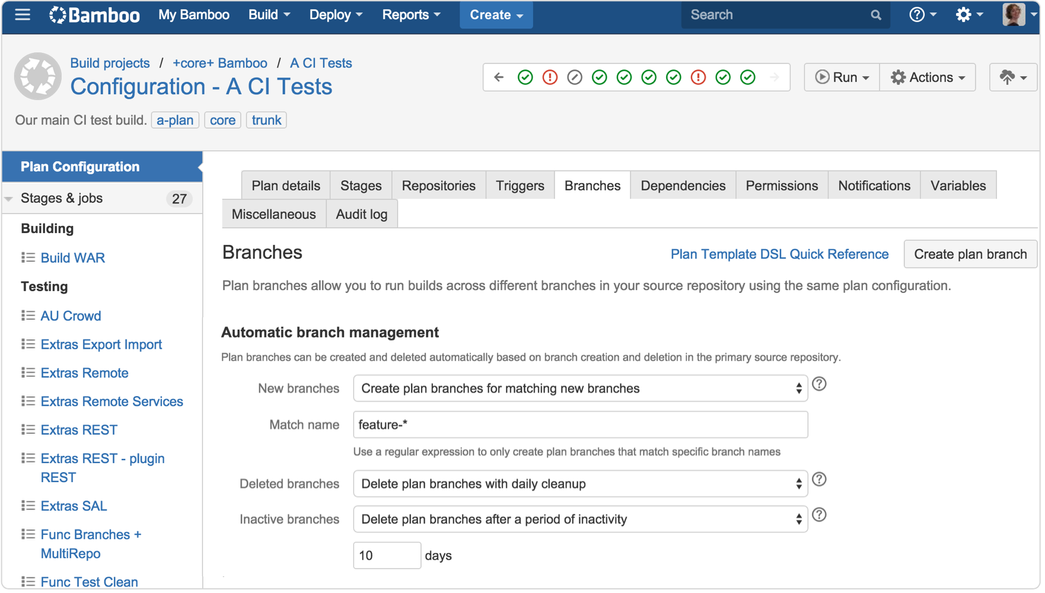
Release pipeline

Slide 5
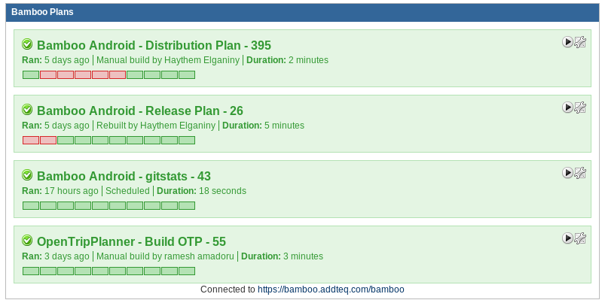
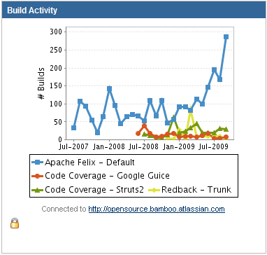
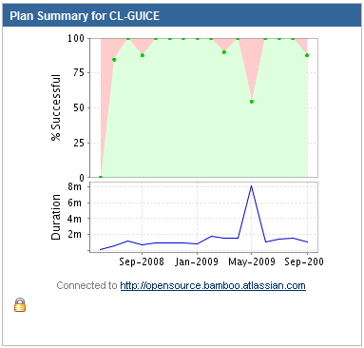
Bamboo gadgets

Slide 6
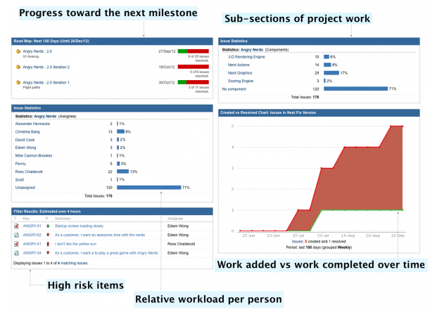
Dashboards for Work in progress tasks
Notes:
Slide not required to be covered during the presentation, but could be left to give a context for offline readers

Slide 7
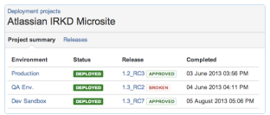
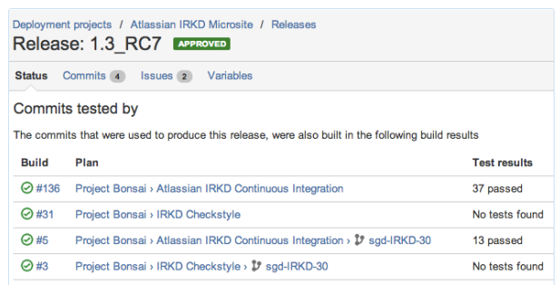
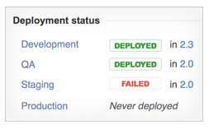
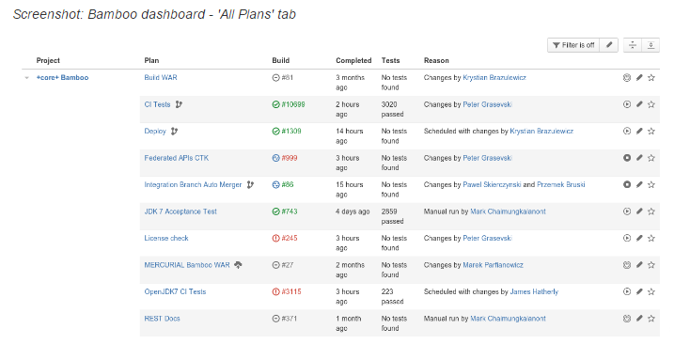
Dashboards – Build and Release
Notes:
Slide not required to be covered during the presentation, but could be left to give a context for offline readers

Slide 8
DEMO
Notes:
Slide not required to be covered during the presentation, but could be left to give a context for offline readers

